Slide 1
Large and Small chaos models: Tiny models can help us understand huge models
One world Numeration Seminar
James Yorke
Institute for Physical Science and Technology & Mathematics & Physics departments
University of Maryland, USA

Slide 2
Tiny models can help us understand huge models .
Jim Yorke
abstract I will be discussing a couple related “simple” maps that tell us a great deal about very complex situations. This is joint work with Roberto De Leo, Yoshi Saiki, Shuddho Das, Miguel Sanjuan, and Hiroki Takahasi. I will report mainly on 3 of our recent papers papers that were accepted for publication last year and are available on arXiv. Plus another that we are working on. Two are on the logistic map rx(1-x). It has uncountably many parameter values with the following property: The map has infinitely many disjoint unstable compact invariant Cantor sets. We have determined how their stable and unstable manifolds interact. All this in a logistic map. Secondly, we have created a baker-like piecewise linear map on a 3D cube that is unstable in 2 dimensions in some places and unstable in 1 in others. It has a dense set of periodic orbits that are 1 D unstable and another dense set of periodic orbits that are all 2 D unstable. The map is ergodic. Lebesgue measure is invariant.

Slide 3
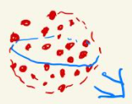
Topic 0: Background for small models Ensemble of initial conditions => Local Ensemble Kalman Filtering
An ensemble of (~100) initial conditions representing possible current conditions
In 1992, Eugenia Kalnay & the US National Weather Service began making an ensemble of multiple forecasts - using slightly different initial conditions.
E. Ott, E., B. R. Hunt, I. Szunyogh, A. V. Zimin, E. J. Kostelich, M. Corazza, E. Kalnay,
D. J. Patil, J. A. Yorke,
A local ensemble Kalman Filter for atmospheric data assimilation, Tellus 56A (2004), 415-428.

Slide 4
Independent of prediction model
But we used the global weather model, the National Centers for Environmental Prediction (NCEP) Global Forecast System (GFS). This operational global atmospheric model is a pseudo-spectral model. IT was obsolete even in 2004
It had192 X 94 horizontal grid points at each of 28 vertical levels. 6 numbers at each grid point: vorticity, temp, ozone, pressure, etc
192 X 94 X 28 X 6 ~ 3,000,000 unknowns
We don’t have enough data to evaluate the
3,000,000 unknowns

Slide 5
Independent of prediction model
But we used the global weather model, the National Centers for Environmental Prediction (NCEP) Global Forecast System (GFS). This operational global atmospheric model is a pseudo-spectral model. IT was obsolete even in 2004
It had192 X 94 horizontal grid points at each of 28 vertical levels. 6 numbers at each grid point: vorticity, temp, ozone, pressure, etc
192 X 94 X 28 X 6 ~ 3,000,000 unknowns
We don’t have enough data to evaluate the
3,000,000 unknowns

Slide 6
Image of initial conditions
After a short time, the image is approximately a linear distortion of the original, expanding in some directions and contracting in others, and maybe neutral in others
D.J. Patil, B.R. Hunt, E. Kalnay, J.A. Yorke, and E. Ott, Local Low Dimensionality of Atmospheric Dynamics, Phys. Rev. Lett. 86, (2001), #26, pp. 5878-5881.
We wanted to develop mathematical methods to improve the quality of weather forecasts without changing the models
By improving the initial data.
By data assimilation
How many observations are needed to identify the new center of the ball of initial conditions, to start today’s forcast?

Slide 7
BR Hunt, E. Kalnay, E.J. Kostelich, E. Ott, DJ Patil, T. Sauer, I. Szunyogh, JA Yorke, and A.V. Zimin, Four-Dimensional Ensemble Kalman Filtering, Tellus 56A, (2004), 273-277.

Slide 8
What I would like to know
What data assimilation method is best for unusual situations on which the model is not trained?
How much variability is there in the local unstable dimension?
“Low-dimensional paradigms for high-dimensional heterochaos” Yoshi Saiki, Miguel A. F. Sanjuán, and J. Yorke Chaos 28, 103110 (2018);

Slide 9
I will tell you about some Small chaos models
Texas Tornados without chaos
(high dim with Lyapunov exponents =0
A 4-piece hetero-chaotic Baker map
A Baker map with a twist
Logistic map graph
Lorenz system (1963) graph
…

Slide 10
Hetero-chaos: Multiple dense sets of periodic points
First our goal was to find a “heterogeneous” 2 or 3 dim. model which has a dense set of
1-dimensionally unstable periodic points,
AND a dense set of
2-dimensionally unstable periodic points

Slide 11
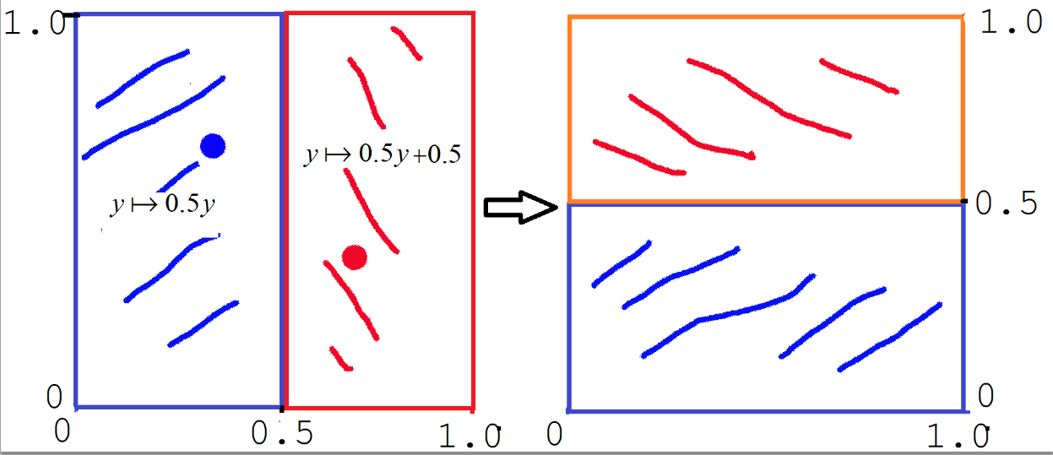
First a HOMOGENOUS model: Traditional 2-piece Baker Map (Seidel 1933) an example of how periodic saddle points can be “dense” Baker map “named” by Paul Halmos
x -> 2x mod 1
Example: period 2 orbit: (1/3,2/3)->(2/3,1/3) -> (1/3,2/3)

Slide 12
An English Lesson: Pizza box: shoe box: long in 2 directions long in 1 dir.

Slide 13
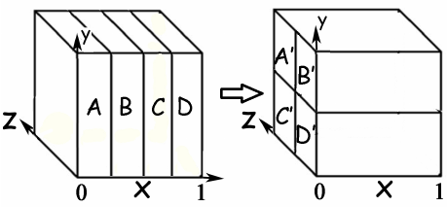
Our 3D version of a Baker Map, contracting in 2D and expanding in 1, x-> 4x mod 1 , preserving volume
The inverse map is expanding along 2 coordinates and contracting in one.

Slide 14
Small chaos models
If there is a dense set of periodic points that are 1-dimensionally unstable, can there be Other dense sets of periodic orbits?

Slide 15
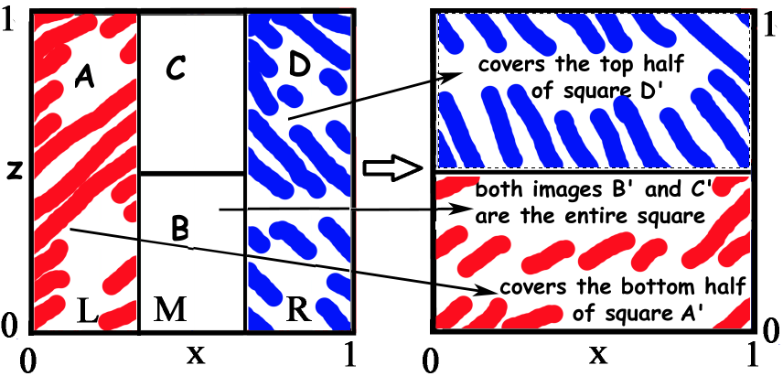
An Area preserving “heterochaotic map”
Side pieces are similar to standard baker map; the center rectangles map onto the entire square.
NOT a subshift of finite type on 4 symbols:
there is no trajectory with symbol sequence
A^{n} then B^{m} then C for n > m,
but A^{m} then B^{m} then C is “admissible”:
there are trajectories with that sequence.

Slide 16
An Area preserving “heterochaotic map”
Side pieces are similar to standard baker map; the center rectangles map onto the entire square.
We have proved (2020) that arbitrarily close to each point, there are periodic saddle points AND periodic repelling points.
NOT a subshift of finite type on 4 symbols:
there is no trajectory with symbol sequence
A^{n} then B^{m} then C for n > m,
but A^{m} then B^{m} then C is “admissible”:
there are trajectories with that sequence.

Slide 17
A one-to-one volume preserving map
Pizza boxes A and D map to shoeboxes A’ and D’;
Shoe boxes B and C map to pizza boxes B’ and C’.

Slide 18
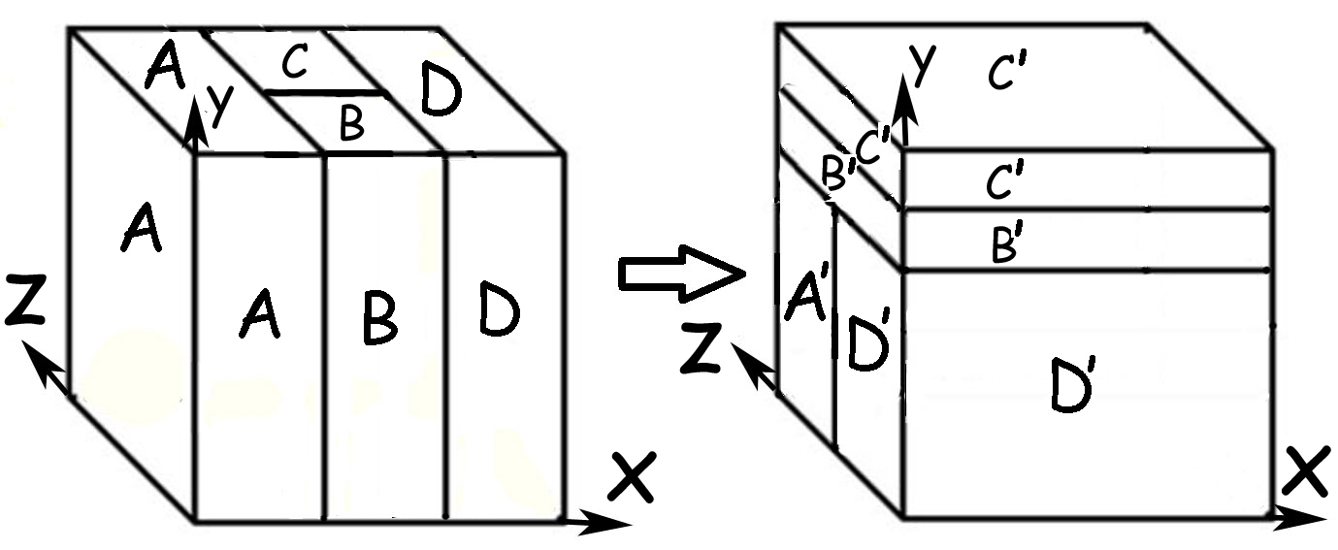
Theorem
The map is ergodic (e.g., most trajectories are dense)
And has hetero-chaos:
1D unstable orbits are dense
2D unstable orbits are dense.
2021 Piecewise linear maps with heterogeneous chaos By Yoshitaka Saiki, Hiroki Takahasi, and JAY in Nonlinearity

Slide 19
Hetero-chaos
Chaos (for this talk) means there is an attractor with a dense trajectory and an infinite dense set of periodic points.
Define k-chaos: chaos + there is a dense set of periodic points whose unstable dimension is k.
Define hetero-chaos: The set S is k-chaotic for two or more values of k. he
We believe that hetero-chaos is typical in high dimensional chaos.
One of our goals is find the simplest examples.
set S is k-chaotic for two or more values of k.

Slide 20
Does one direction have to be the most expansive?
(the X direction in the above map).
(Or the Y direction in the inverse map).
.

Slide 21
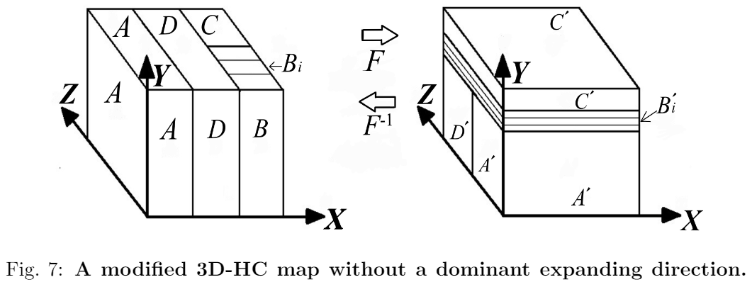
For F the X expansion is always a factor of 3 but in
Bi as drawn the expansion in Z 6.
For F^-1 Y is always expanding but in some rectangles like A’, the expansion in Z is 2, which is greater that the expansion of Y which is 3/2.

Slide 22
Hetero-chaos
“Chaos” (for this talk) means there is an attractor with a dense trajectory and an infinite dense set of periodic points.
Define k-chaos: chaos + there is a dense set of periodic points whose unstable dimension is k.
Define hetero-chaos: The set S is k-chaotic for two or more values of k. he
We believe that hetero-chaos is typical in high dimensional chaos.
We believe that hetero-chaos is typical in high dimensional chaos
We try to find the simplest, explicit, concrete examples.
Abraham-Smale (1968) etc including Lorenzo Diaz & Christian Bonatti have developed a theory that can produce abstract hetero-chaotic non-attractors.
New examples with infinitely many sinks robustly (Berger-Crovisier-Pujals 2021)

Slide 23
Continuing the theme of VARIABLE unstable dimensions Joint work with Shuddho Das, Yoshi Saiki, Miguel Sanjuan, Hiroki Takahasi Published 2017 & 2018 & 2021 & 2021-submitted. (See arXiv for versions of these.) We believe that heterogeneous chaos is typical in high-dimensional chaos but is Not in standard low-dimensional models (at least in expositions). Important Literature: Abraham-Smale (1968) etc including Lorenzo Diaz & Christian Bonatti have developed a theory that can produce abstract hetero-chaotic non-attractors. New examples with infinitely many sinks robustly (Berger-Crovisier-Pujals 2021)

Slide 24
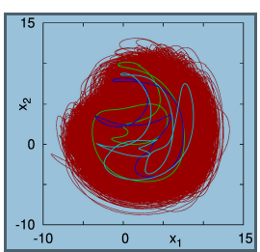
Lorenz96 a model of dimension N
3 periodic orbits with unstable
dimensions 1,2, and 3
in the (red) attractor
The subscripts are defined cyclically
so that they are between 1 and N
Lorenz focused on N = 40 but we
look at N =8 and F=8.

Slide 25
With a twist

Slide 26
New map: AN ERGODIC BAKER MAP WITH A TWIST work with Yoshi Saiki and Hiroki Takahasi
Our N-dim twist map on 2 cubes:
First: Twist Right cube about long axis;
2nd: stretch each cube onto the double cube.

Slide 27
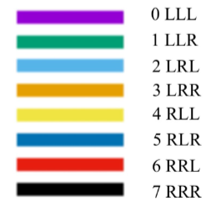
Each colored piece has volume ¼ and is mapped to the whole space in 3 iterates. Total volume = 2.

Slide 28
The N-dimensional TWIST map Theorem on 2 unit cubes
Theorem
1) The map is ergodic; almost every trajectory’s is dense in the whole space (i.e., 2 cubes)
2) Repelling periodic points are
dense.
The methods of proof are new.
This result will soon be submitted for publication.

Slide 29
10,000 iterates of one trajectory of our 2D twist map

Slide 30
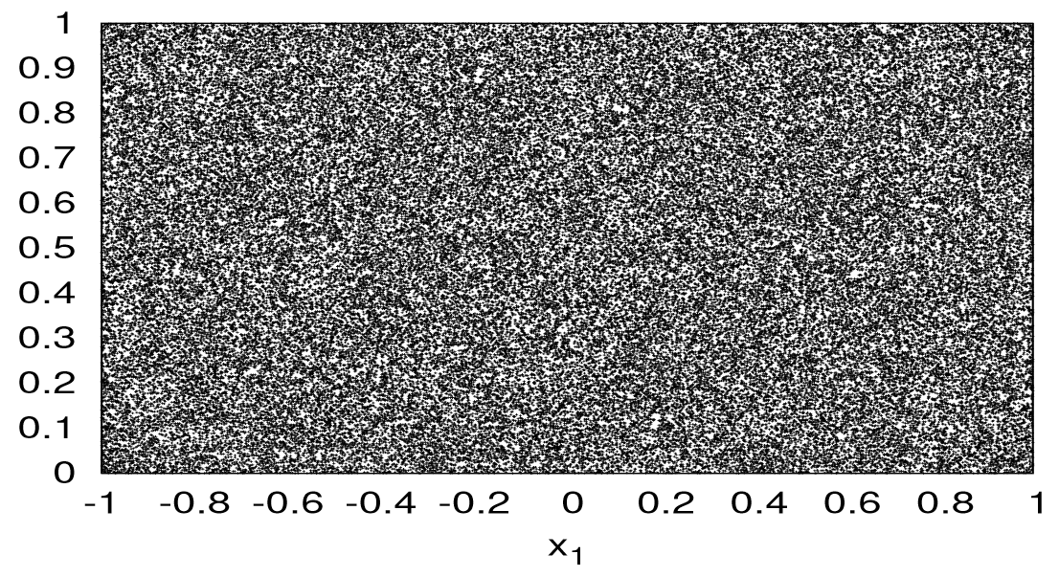
100,000 iterates of 2D twist map

Slide 31
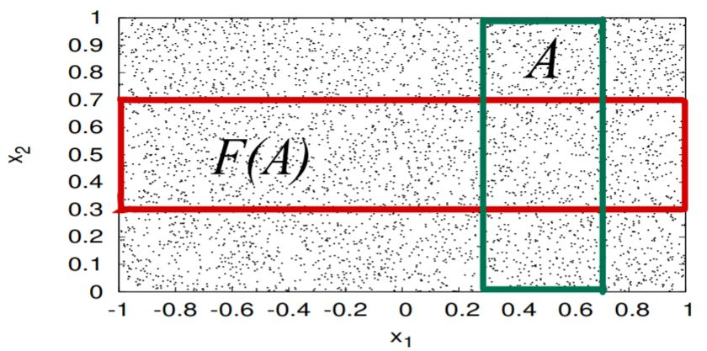
Rectangles map to rectangles in Dimension 2. (1,1) is a fixed point. F is continuous on A
does not contain a fixed point. (1,1) is the fixed point for F on the right side of the space.

Slide 32
New topic: The Logistic map’s “graph” and Lorenz’s
Understanding the simplest dynamical systems
x_{n+1} = rx_{n}(1-x_{n})
2 papers published in 2021 – See arXiv --
with Roberto De Leo (Howard University, Washington,DC, USA)

Slide 33
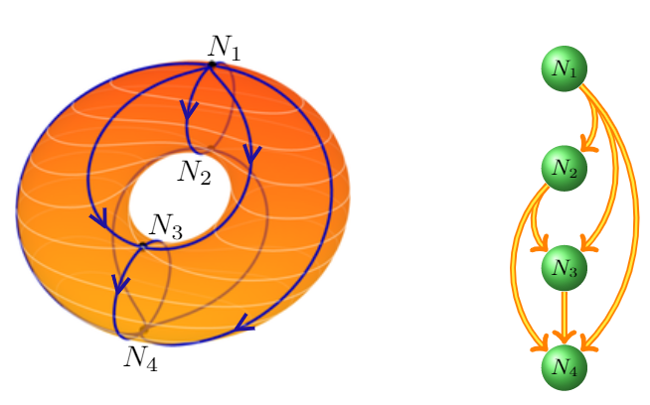
Graphs of a Dynamical System two approaches (Steve Smale: non-wandering set Morse-Smale graph): (Charles Conley: chain-recurrent set)
4 nodes (isolated fixed points here)
1 repellor at top
2 saddles
1 attractor at bottom
We call this is a “Tower”:
6 directed edges:
Every pair is connected,
with one directed edge,
From the higher to the
lower.

Slide 34
Logistic period 3 window
The graph of the logistic map x_{n+1}=rx_{n}(1-x_{n}) for each r, 1 ≤ r ≤ 4
0 ≤ x ≤ 1
3 ≤ r ≤ 4
“ I see a period 3 attractor,
not an uncountable set!!!”

Slide 35
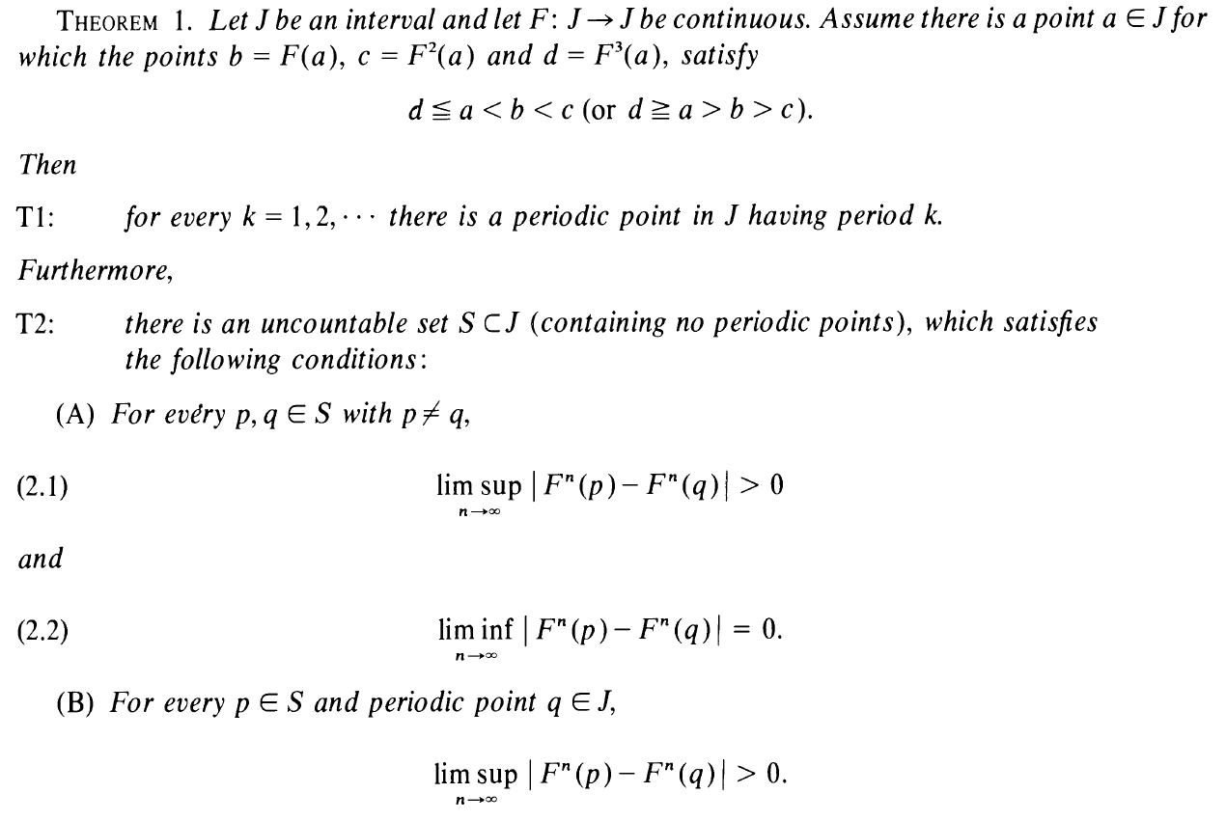
Period 3 implies chaos (Li & Yorke) 1975
A continuous map on an Interval
with a period 3 orbit has
T1: Lots of periodic orbits, and
T2: There is an uncountable set S on which the map is mixing.

Slide 36
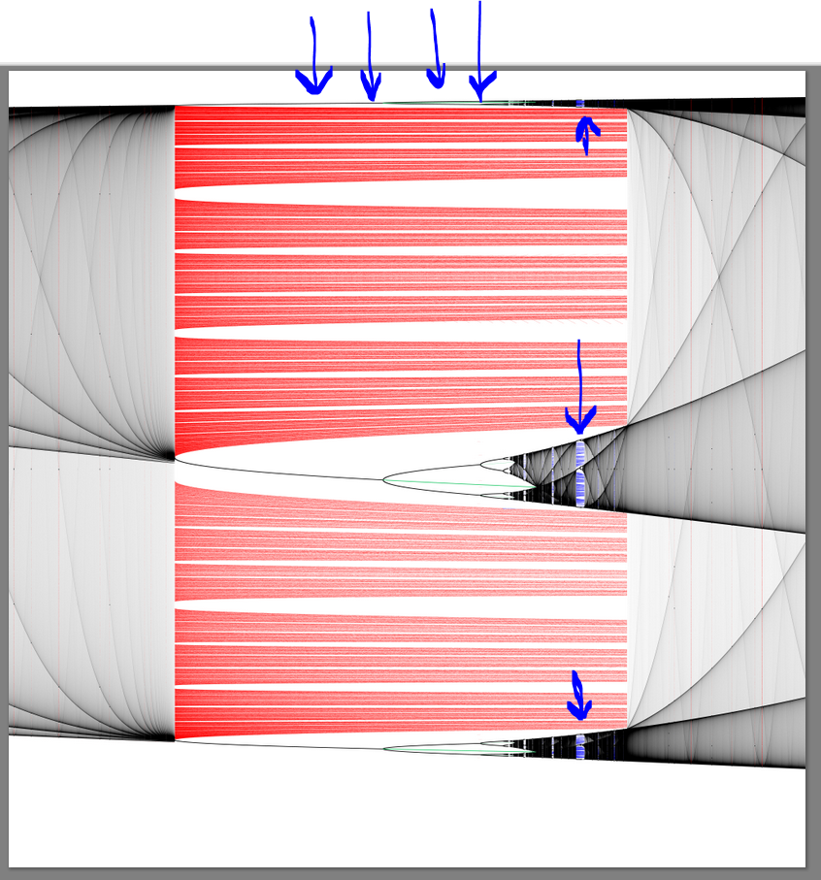
Smale and Williams Theorem 1976
There is a hyperbolic
chaotic set in
the period 3 window.
And a period 3 window
within the window.
Logistic
Graph bifurcation diagram
by
De Leo & Yorke 2021
Notice the Crisis at the end ^ of the window (GOY 1983)

Slide 37
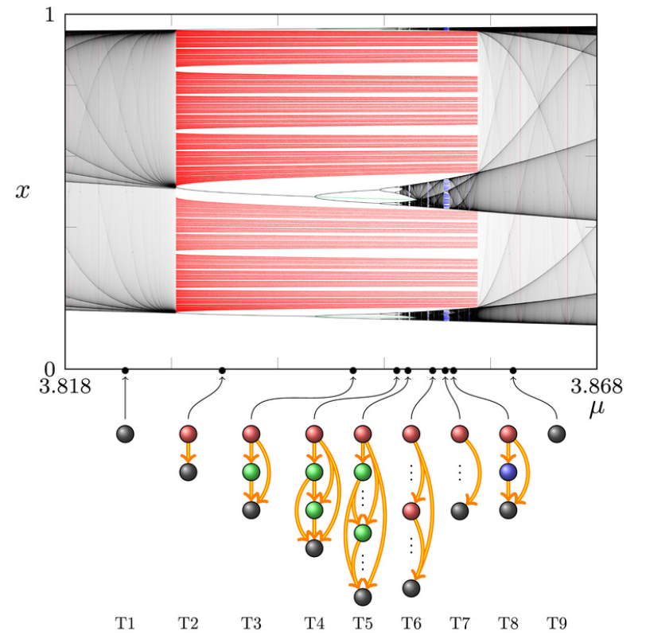
The towers for several
parameter values within
the period 3 window.

Slide 38
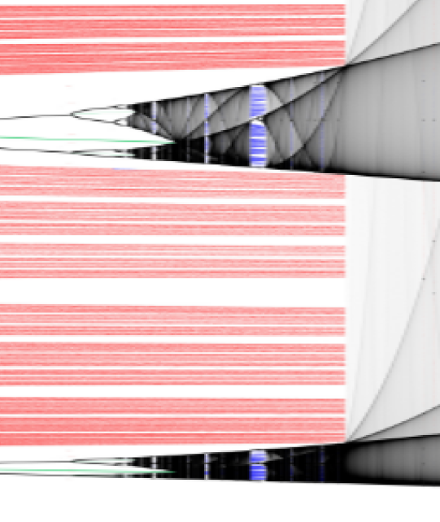
The towers for several
parameter values within
the period 3 window.

Slide 39
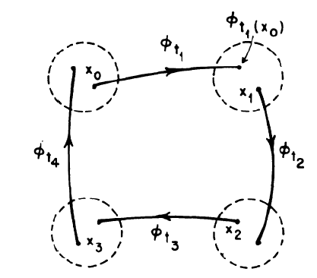
Graphs of Dynamical Systems: Charles Conley
Each node is a maximal chain-recurrent set:
isolated fixed points or periodic orbits or hyperbolic chaotic sets;
for any pair of points p,q in a node, there is an ε-chain from p to q and from q to p
This is an example a point x1 whose
Chain trajectory returns back to itself.

Slide 40
We call a graph a “tower’’ if each pair of nodes is connected by an edge:
The bottom node is an attractor (in the sense of Milnor).
In the logistic map, each additional node is either an unstable periodic orbit
or a chaotic saddle;
there can be infinitely many, occurring in every pattern of periodic vs chaotic.
Our Theorem
(De Leo & Y 2021):
For each parameter value r, 1< r ≤ 4
the GRAPH
of the logistic map,
r x (1-x),
is a tower.
What’s new here?
The EDGES.
2021_De_Leo-Y-DCDS_The_graph_of_the_logistic_map_is_a_tower
Discrete and Continuous Dynamical Systems:
De Leo and Y
2021_De_Leo-Y-NOND_Infinite_towers in the graph of a dynamical system
Roberto De Leo and Y
NOND = Nonlinear Dynamics

Slide 41
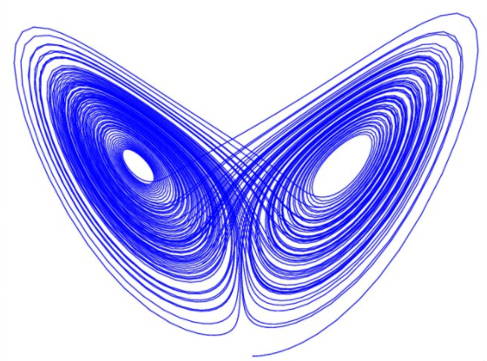
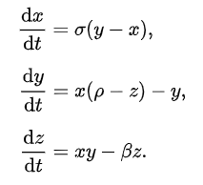
The Logistic map’s “bifurcation graph” has strong similarities with the Lorenz’s
From Wikipedia
Why do we compare these two?
Very similar graph bifurcation diagrams,
(tho the Lorenz system can have multiple attractors).

Slide 42
We use the usual Lorenz return map for z= r-1 Lorenz used r = 28. We look at r ~ 208 >> 30

Slide 43
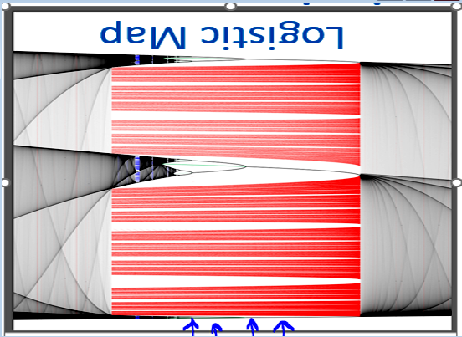
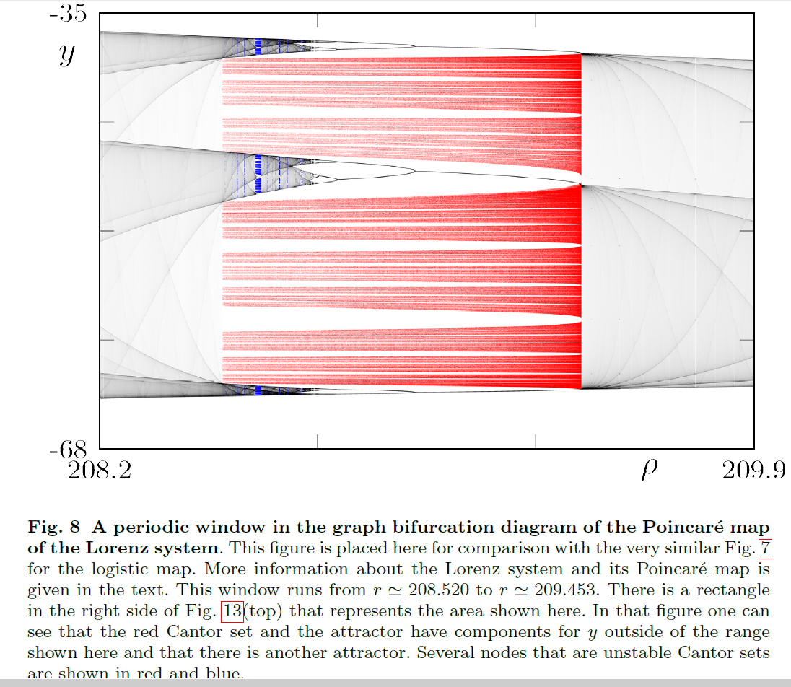
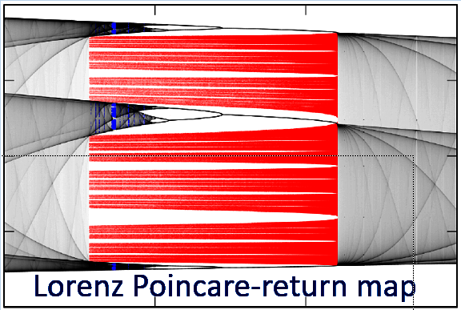
Compare: Lorenz and Logistic “Graph-bifurcation” diagrams
Logistic Map

Slide 44
Compare: Lorenz and Logistic Graphbifurcation diagrams
Logistic Map
Crises: sudden jumps in a chaotic attractor as a parameter changes.
These are common as the chaotic saddle gets absorbed into the attractor.

Slide 45
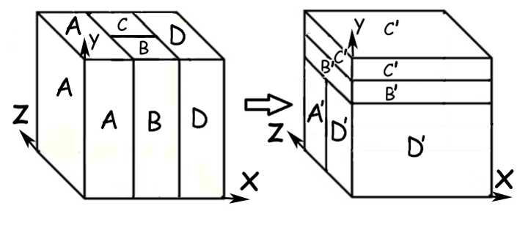
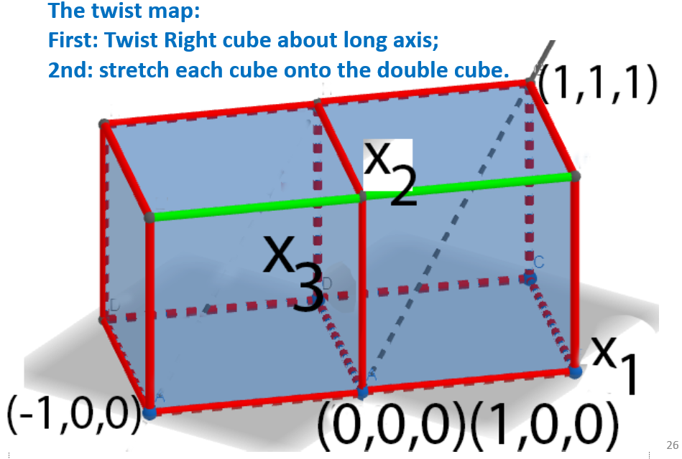
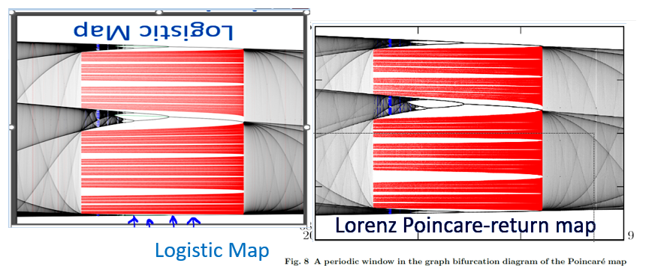
Summary in pictures
Hetero-chaos
Shuddho Das, Yoshi Saiki, Miguel Sanjuan, Hiroki Takahasi, JAY
Weather initialization:
M. Corazza, Brian Hunt, Eugenia Kalnay,
Eric Kostelich, Ed Ott, DJ Patil, Tim Sauer,
Istvan Szunyogh, JY, Aleksey Zimin
Roberto De Leo, JY
Twist: Yoshi Saiki, Hiroki Takahasi, JY

Slide 46
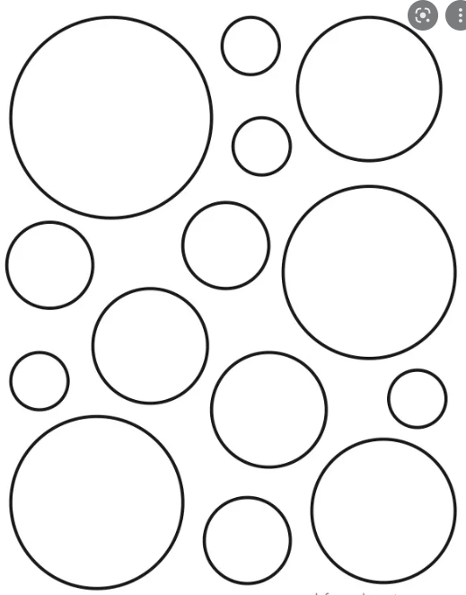

Slide 47
Edward Lorenz’s title: Does the flap of a butterfly’s wings in Brazil set off a tornado in Texas?
Yoshi Saiki, Hiroki Takahasi, JY
preliminary title:
Does the flap of butterfly's wings shift a tornado into Texas -- without chaos?

Slide 52
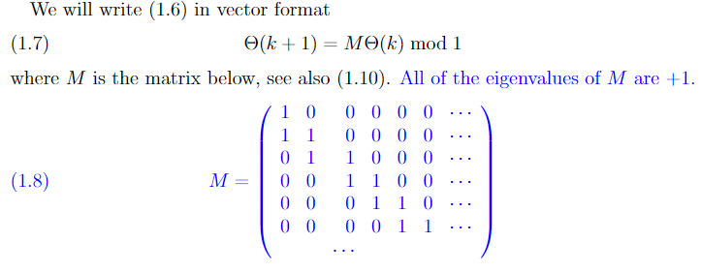

Slide 53
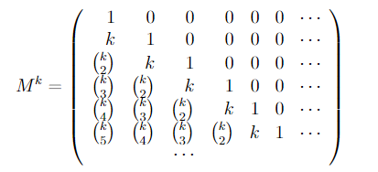

Slide 54
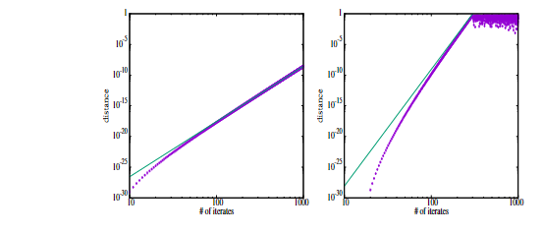

Slide 55
Small perturbations ε=10⁻³⁰ grow rapidly

