Slide 1
Information complexity and exact communication bounds
Mark Braverman
Princeton University
April 26, 2013
Based on joint work with Ankit Garg, Denis Pankratov, and Omri Weinstein

Slide 2
Overview: information complexity
Information complexity ::
communication complexity
as
Shannon’s entropy ::
transmission cost

Slide 3
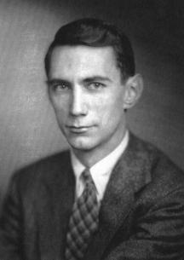


Background – information theory
Shannon (1948) introduced information theory as a tool for studying the communication cost of transmission tasks.
communication channel
Alice
Bob

Slide 4

Shannon’s entropy
Assume a lossless binary channel.
A message $X$ is distributed according to some prior $μ$.
The inherent amount of bits it takes to transmit $X$ is given by its entropy
$H\left(X\right)=\sum{μ\left[X=x\right]\log_{2}⁡(1/μ⁡[X=x])}$.
X
communication channel

Slide 5

Shannon’s noiseless coding
The cost of communicating many copies of $X$ scales as $H(X)$.
Shannon’s source coding theorem:
  Let $C_{n}\left(X\right)$ be the cost of transmitting $n$ independent copies of $X$. Then the amortized transmission cost
  $\lim_{n→∞}{C_{n}(X)/n}=H\left(X\right)$.

Slide 6


Shannon’s entropy – cont’d
Therefore, understanding the cost of transmitting a sequence of $X$’s is equivalent to understanding Shannon’s entropy of $X$.
What about more complicated scenarios?
X
communication channel
Y
Amortized transmission cost = conditional entropy $H\left(X | Y\right)≔H\left(XY\right)−H(Y)$.

Slide 7
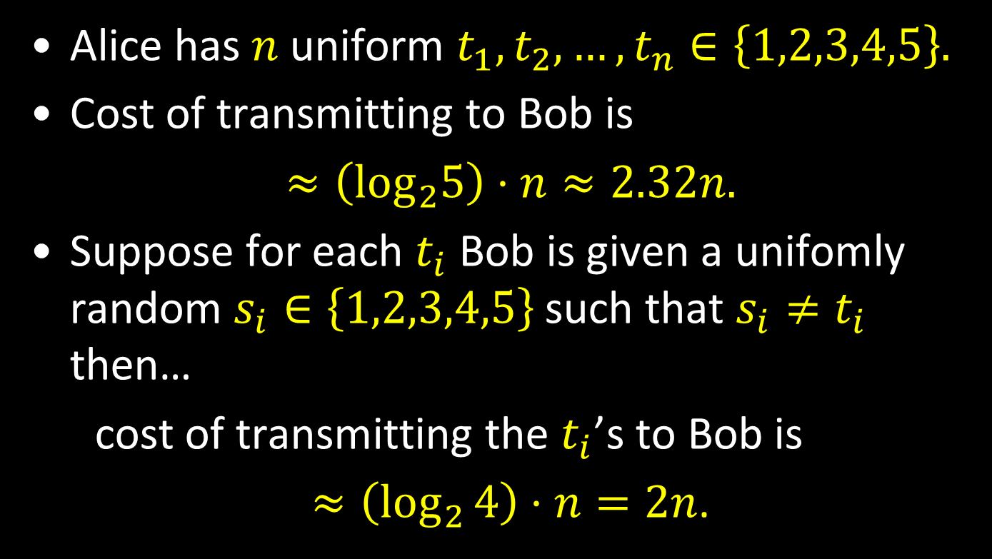
A simple example
Easy and complete!
Alice has $n$ uniform $t_{1},t_{2},…,t_{n}∈\left\{1,2,3,4,5\right\}.$
Cost of transmitting to Bob is
$≈\left(\log_{2}5\right)⋅n≈2.32n.$
Suppose for each $t_{i}$ Bob is given a unifomly random $s_{i}∈\left\{1,2,3,4,5\right\}$ such that $s_{i}≠t_{i}$ then…
cost of transmitting the $t_{i}$’s to Bob is
$≈\left(\log_{2}{4}\right)⋅n=2n$.

Slide 8
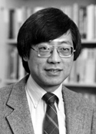




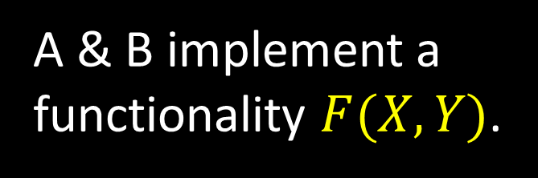
Communication complexity [Yao]
Meanwhile, in a galaxy far far away…
Focus on the two party randomized setting.
Shared randomness R
X
A & B implement a functionality $F(X,Y)$.
Y
F(X,Y)
A
B
e.g. $F\left(X,Y\right)=“X=Y?”$

Slide 9
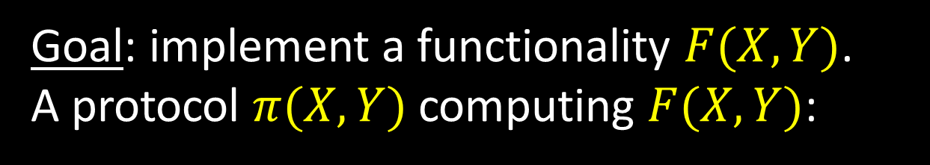
Communication complexity
Goal: implement a functionality $F(X,Y)$.
A protocol $π(X,Y)$ computing $F(X,Y)$:
Shared randomness R
X
m₁(X,R)
Y
m₂(Y,m₁,R)
m₃(X,m₁,m₂,R)
A
B
F(X,Y)
Communication cost = #of bits exchanged.

Slide 10
Communication complexity
Numerous applications/potential applications (streaming, data structures, circuits lower bounds…)
Considerably more difficult to obtain lower bounds than transmission (still much easier than other models of computation).
Many lower-bound techniques exists.
Exact bounds??

Slide 11

Communication complexity
(Distributional) communication complexity with input distribution $μ$ and error $ε$: $CC\left(F,μ,ε\right).$ Error $≤ε$ w.r.t. $μ$.
(Randomized/worst-case) communication complexity: $CC(F,ε)$. Error $≤ε$ on all inputs.
Yao’s minimax:
$CC\left(F,ε\right)=\max_{μ}{CC(F,μ,ε)}$.

Slide 12
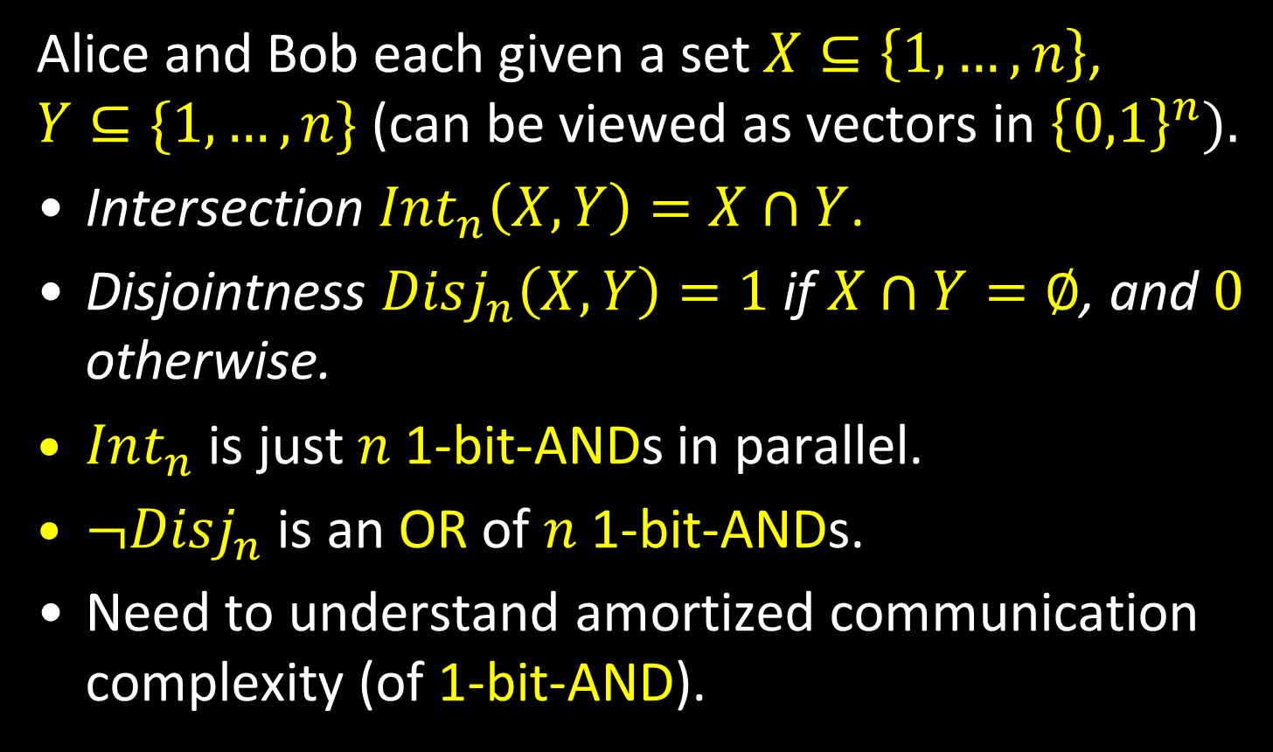
Set disjointness and intersection
Alice and Bob each given a set $X⊆\left\{1,…,n\right\}$, $Y⊆\{1,…,n\}$ (can be viewed as vectors in ${\left\{0,1\right\}}^{n}).$
Intersection $Int_{n}\left(X,Y\right)=X∩Y$.
Disjointness $Disj_{n}\left(X,Y\right)=1$ if $X∩Y=∅$, and $0$ otherwise.
$Int_{n}$ is just $n$ 1-bit-ANDs in parallel.
$¬Disj_{n}$ is an OR of $n$ 1-bit-ANDs.
Need to understand amortized communication complexity (of 1-bit-AND).

Slide 13

Information complexity
The smallest amount of information Alice and Bob need to exchange to solve $F$.
How is information measured?
Communication cost of a protocol?
  Number of bits exchanged.
Information cost of a protocol?
  Amount of information revealed.

Slide 14

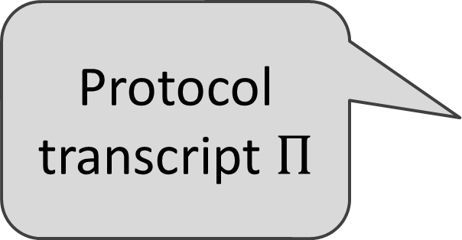
Basic definition 1: The information cost of a protocol
Prior distribution: $\left(X,Y\right)∼μ$.
X
Y
Protocol transcript $Π$
Protocol π
A
B
$$IC(π, μ) = I(Π;Y|X) + I(Π;X|Y)$$
what Alice learns about Y + what Bob learns about X

Slide 15

Mutual information
The mutual information of two random variables is the amount of information knowing one reveals about the other:
$$I(A;B) = H(A)−H(A|B)$$
If $A,B$ are independent, $I(A;B)=0$.
$I(A;A)=H(A)$.
H(A)
I(A,B)
H(B)

Slide 16
Basic definition 1: The information cost of a protocol
Prior distribution: $\left(X,Y\right)∼μ$.
X
Y
Protocol transcript $Π$
Protocol π
A
B
$$IC(π, μ) = I(Π;Y|X) + I(Π;X|Y)$$
what Alice learns about Y + what Bob learns about X

Slide 17
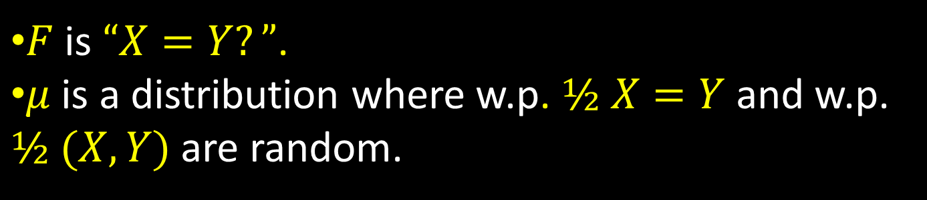
Example
$F$is $“X=Y?”$.
$μ$is a distribution where w.p. $½ X=Y$ and w.p. $½$ $(X,Y)$ are random.
X
Y
MD5(X) [128 bits]
X=Y? [1 bit]
A
B
$I(π, μ) = I(Π;Y|X)+I(Π;X|Y) ≈$1 + 64.5 = 65.5 bits
what Alice learns about Y + what Bob learns about X

Slide 18
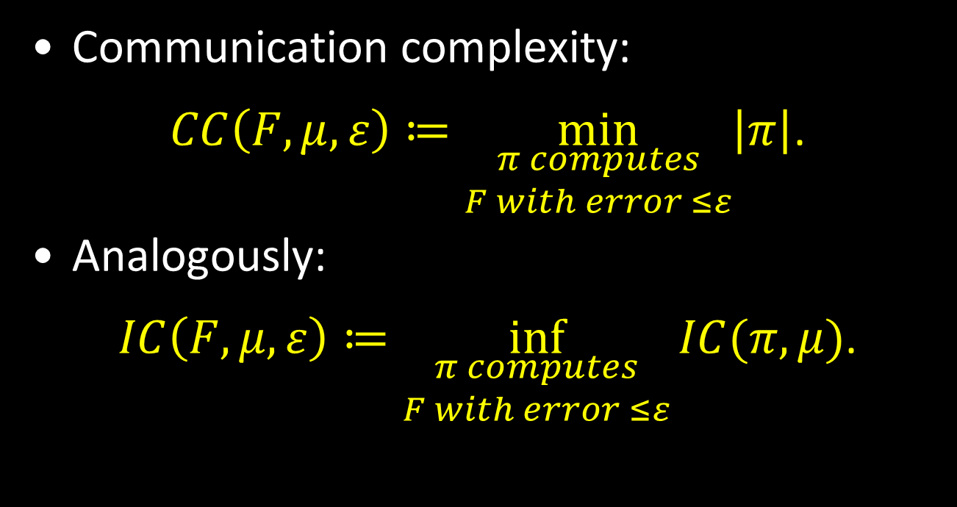
Information complexity
Communication complexity:
$CC\left(F,μ,ε\right)≔\min_{\begin{aligned}π computes \\ F with error ≤ε\end{aligned}}\left|π\right|$.
Analogously:
$IC\left(F,μ,ε\right)≔\inf_{\begin{aligned}π computes \\ F with error ≤ε\end{aligned}}{IC(π,μ)}$.

Slide 19

Prior-free information complexity
Using minimax can get rid of the prior.
For communication, we had:
$CC\left(F,ε\right)=\max_{μ}{CC(F,μ,ε)}$.
For information
$IC\left(F,ε\right)≔\inf_{\begin{aligned}π computes \\ F with error ≤ε\end{aligned}}{\max_{μ}{ IC(π,μ)}}$.

Slide 20


Connection to privacy
There is a strong connection between information complexity and (information-theoretic) privacy.
Alice and Bob want to perform computation without revealing unnecessary information to each other (or to an eavesdropper).
Negative results through $IC$arguments.

Slide 21
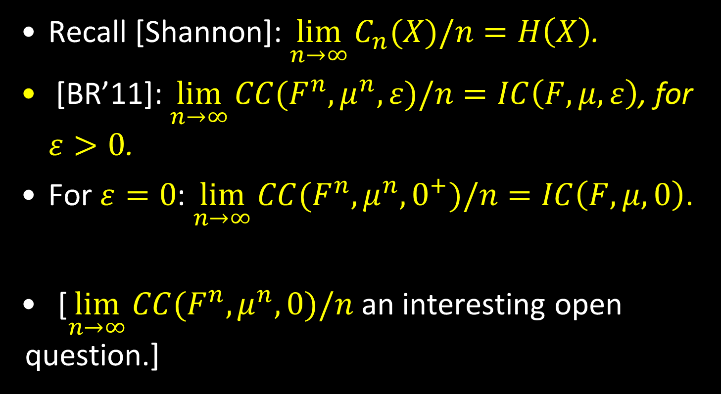
Information equals amortized communication
  Recall [Shannon]: $\lim_{n→∞}{C_{n}(X)/n}=H\left(X\right)$.
  [BR’11]: $\lim_{n→∞}{CC(F^{n},μ^{n},ε)/n}=IC\left(F,μ,ε\right)$, for $ε>0$.
  For $ε=0$: $\lim_{n→∞}{CC(F^{n},μ^{n},0^{+})/n}=IC\left(F,μ,0\right)$.
[$\lim_{n→∞}{CC(F^{n},μ^{n},0)/n}$ an interesting open question.]

Slide 22

Without priors
[BR’11] For $ε=0$: $\lim_{n→∞}{CC(F^{n},μ^{n},0^{+})/n}=IC\left(F,μ,0\right)$.
[B’12] $\lim_{n→∞}{CC(F^{n},0^{+})/n}=IC\left(F,0\right)$.

Slide 23

Intersection
Therefore
$$CC\left(Int_{n},0^{+}\right)=n⋅IC\left(AND,0\right)±o(n)$$
Need to find the information complexity of the two-bit $AND$!

Slide 24

The two-bit AND
[BGPW’12] $IC\left(AND,0\right)≈1.4922$ bits.
Find the value of $IC\left(AND,μ,0\right)$ for all priors $μ$.
Find the information-theoretically optimal protocol for computing the $AND$of two bits.

Slide 25
The optimal protocol for AND
“Raise your hand when your number is reached”
X{0,1}
1
Y{0,1}
A
B
If X=1, A=1
If X=0, A=U_{[0,1]}
If Y=1, B=1
If Y=0, B=U_{[0,1]}
0

Slide 26
The optimal protocol for AND
“Raise your hand when your number is reached”
X{0,1}
1
Y{0,1}
A
B
If X=1, A=1
If X=0, A=U_{[0,1]}
If Y=1, B=1
If Y=0, B=U_{[0,1]}
0

Slide 27

Analysis
An additional small step if the prior is not symmetric ($\operatorname{Pr}\left[XY=10\right]≠Pr⁡[XY=01]$).
The protocol is clearly always correct.
How do we prove the optimality of a protocol?
Consider the function $IC(F,μ,0)$ as a function of $μ$.

Slide 28
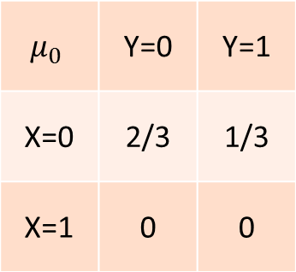
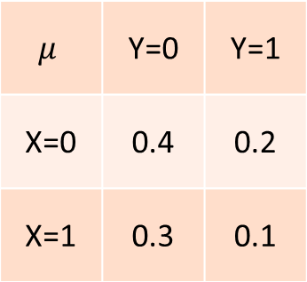
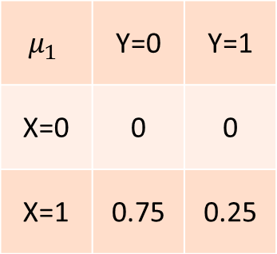
The analytical view
A message is just a mapping from the current prior to a distribution of posteriors (new priors). Ex:
$$μ_{0}$$ | Y=0 | Y=1
X=0 | 2/3 | 1/3
X=1 | 0 | 0
“0”: 0.6
$$μ$$ | Y=0 | Y=1
X=0 | 0.4 | 0.2
X=1 | 0.3 | 0.1
$$μ_{1}$$ | Y=0 | Y=1
X=0 | 0 | 0
X=1 | 0.75 | 0.25
“1”: 0.4
Alice sends her bit

Slide 29
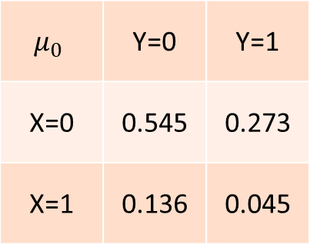
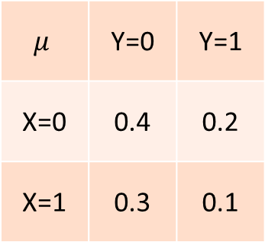
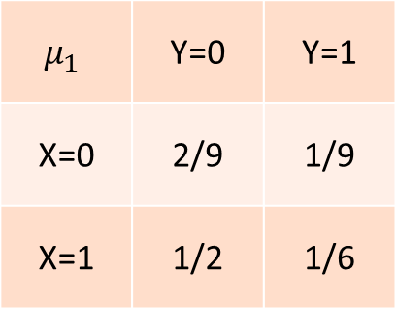
The analytical view
$$μ_{0}$$ | Y=0 | Y=1
X=0 | 0.545 | 0.273
X=1 | 0.136 | 0.045
“0”: 0.55
$$μ$$ | Y=0 | Y=1
X=0 | 0.4 | 0.2
X=1 | 0.3 | 0.1
$$μ_{1}$$ | Y=0 | Y=1
X=0 | 2/9 | 1/9
X=1 | 1/2 | 1/6
“1”: 0.45
Alice sends her bit w.p ½ and unif. random bit w.p ½.

Slide 30
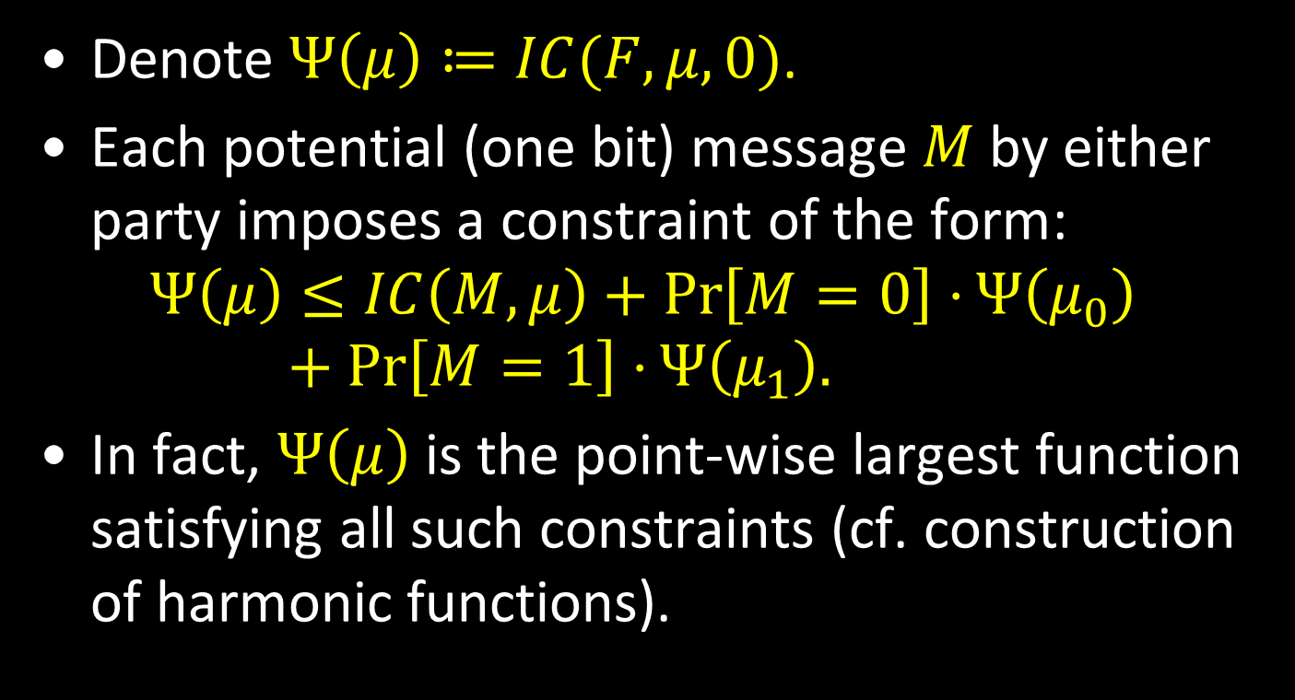
Analytical view – cont’d
Denote $Ψ\left(μ\right)≔IC(F,μ,0)$.
Each potential (one bit) message $M$ by either party imposes a constraint of the form:
$$Ψ\left(μ\right)≤IC\left(M,μ\right)+\operatorname{Pr}\left[M=0\right]⋅Ψ\left(μ_{0}\right)+\operatorname{Pr}\left[M=1\right]⋅Ψ\left(μ_{1}\right).$$
In fact, $Ψ\left(μ\right)$ is the point-wise largest function satisfying all such constraints (cf. construction of harmonic functions).

Slide 31

IC of AND
We show that for $π_{AND}$ described above, $Ψ_{π}\left(μ\right)≔IC\left(π_{AND},μ\right)$ satisfies all the constraints, and therefore represents the information complexity of $AND$at all priors.
Theorem: $π$ represents the information-theoretically optimal protocol* for computing the $AND$of two bits.

Slide 32

*Not a real protocol
The “protocol” is not a real protocol (this is why IC has an inf in its definition).
The protocol above can be made into a real protocol by discretizing the counter (e.g. into $r$ equal intervals).
We show that the $r$-round IC:
$$IC_{r}\left(AND,0\right)=IC\left(AND,0\right)+Θ\left(\frac{1}{r^{2}}\right).$$

Slide 33
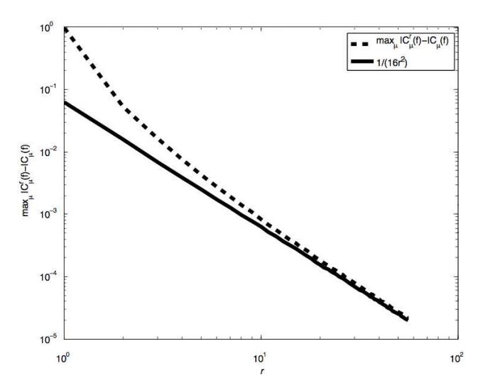
Previous numerical evidence
[Ma,Ishwar’09] – numerical calculation results.

Slide 34

Applications: communication complexity of intersection
Corollary:
$$CC\left(Int_{n},0^{+}\right)≈1.4922⋅n±o\left(n\right).$$
Moreover:
$$CC_{r}\left(Int_{n},0^{+}\right)≈1.4922⋅n+Θ\left(\frac{n}{r^{2}}\right).$$

Slide 35

Applications 2: set disjointness
Recall: $Disj_{n}\left(X,Y\right)=1_{X∩Y=∅}$.
Extremely well-studied. [Kalyanasundaram and Schnitger’87, Razborov’92, Bar-Yossef et al.’02]: $CC\left(Disj_{n},ε\right)=Θ(n)$.
What does a hard distribution for $Disj_{n}$ look like?

Slide 36
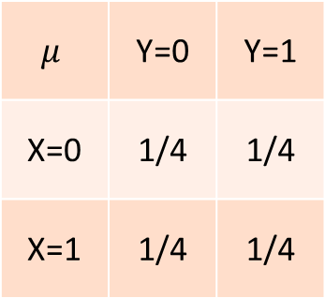
A hard distribution?
0 | 0 | 1 | 1 | 0 | 1 | 0 | 0 | 0 | 1 | 0 | 0 | 1 | 1 | 1 | 1 | 0 | 1 | 1 | 0 | 0
1 | 0 | 1 | 0 | 0 | 1 | 1 | 1 | 0 | 0 | 1 | 1 | 1 | 0 | 1 | 0 | 1 | 1 | 0 | 0 | 0
Very easy!
$$μ$$ | Y=0 | Y=1
X=0 | 1/4 | 1/4
X=1 | 1/4 | 1/4

Slide 37
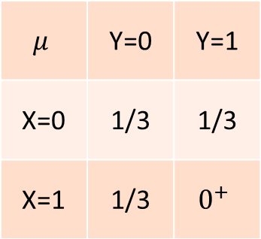
A hard distribution
0 | 0 | 0 | 1 | 0 | 1 | 0 | 0 | 0 | 1 | 0 | 0 | 1 | 1 | 0 | 1 | 0 | 1 | 1 | 0 | 0
1 | 0 | 1 | 0 | 0 | 0 | 1 | 1 | 0 | 0 | 1 | 1 | 1 | 0 | 0 | 0 | 1 | 0 | 0 | 0 | 0
At most one (1,1) location!
$$μ$$ | Y=0 | Y=1
X=0 | 1/3 | 1/3
X=1 | 1/3 | $$0^{+}$$

Slide 38
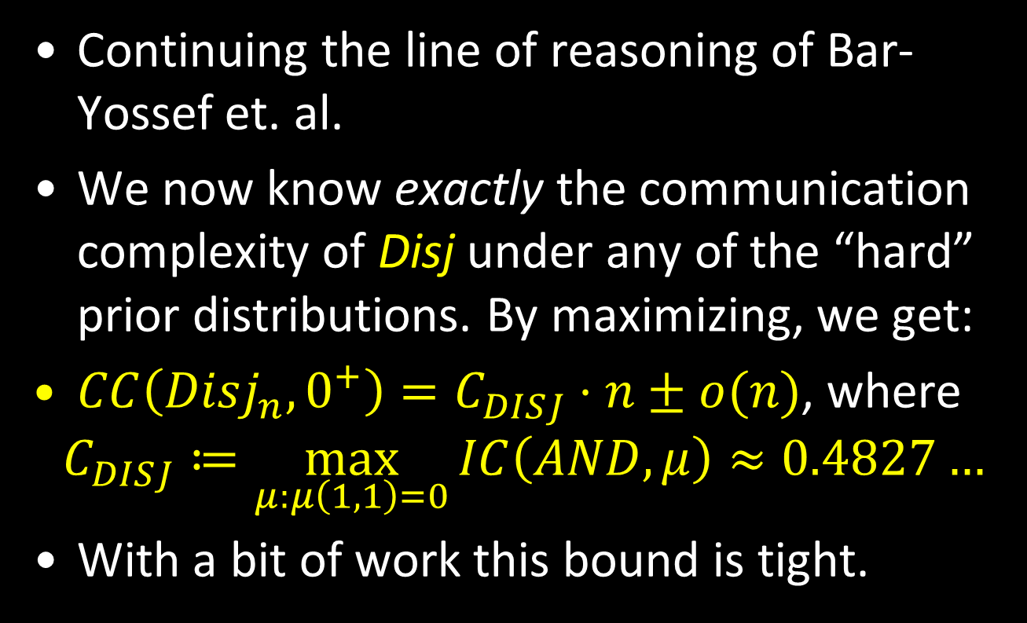
Communication complexity of Disjointness
Continuing the line of reasoning of Bar-Yossef et. al.
We now know exactly the communication complexity of Disj under any of the “hard” prior distributions. By maximizing, we get:
$CC\left(Disj_{n},0^{+}\right)=C_{DISJ}⋅n±o(n)$, where
$$C_{DISJ}≔\max_{μ:μ\left(1,1\right)=0}{IC\left(AND,μ\right)}≈0.4827…$$
With a bit of work this bound is tight.

Slide 39

Small-set Disjointness
A variant of set disjointness where we are given $X,Y⊂\{1,…n\}$ of size $k≪n$.
A lower bound of $Ω\left(k\right)$ is obvious (modulo $CC\left(Disj_{n}\right)=Ω(n)$).
A very elegant matching upper bound was known [Hastad-Wigderson’07]: $Θ\left(k\right)$.

Slide 40
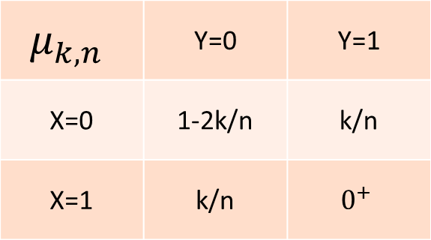
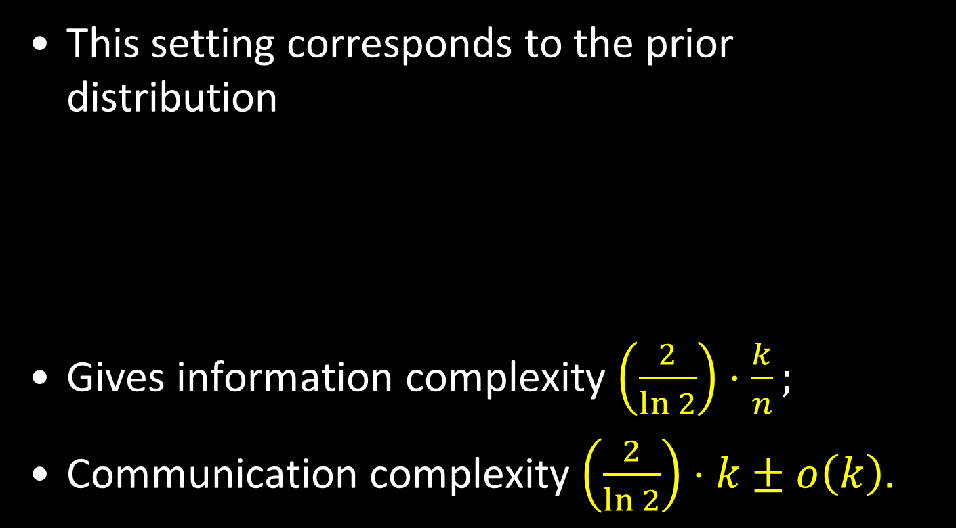
Using information complexity
This setting corresponds to the prior distribution
Gives information complexity $\left(\frac{2}{\ln{2}}\right)⋅\frac{k}{n};$
Communication complexity $\left(\frac{2}{\ln{2}}\right)⋅k±o\left(k\right).$
$$μ_{k,n}$$ | Y=0 | Y=1
X=0 | 1-2k/n | k/n
X=1 | k/n | $$0^{+}$$

Slide 41
Overview: information complexity
Information complexity ::
communication complexity
as
Shannon’s entropy ::
transmission cost
Today: focused on exact bounds using IC.

Slide 42
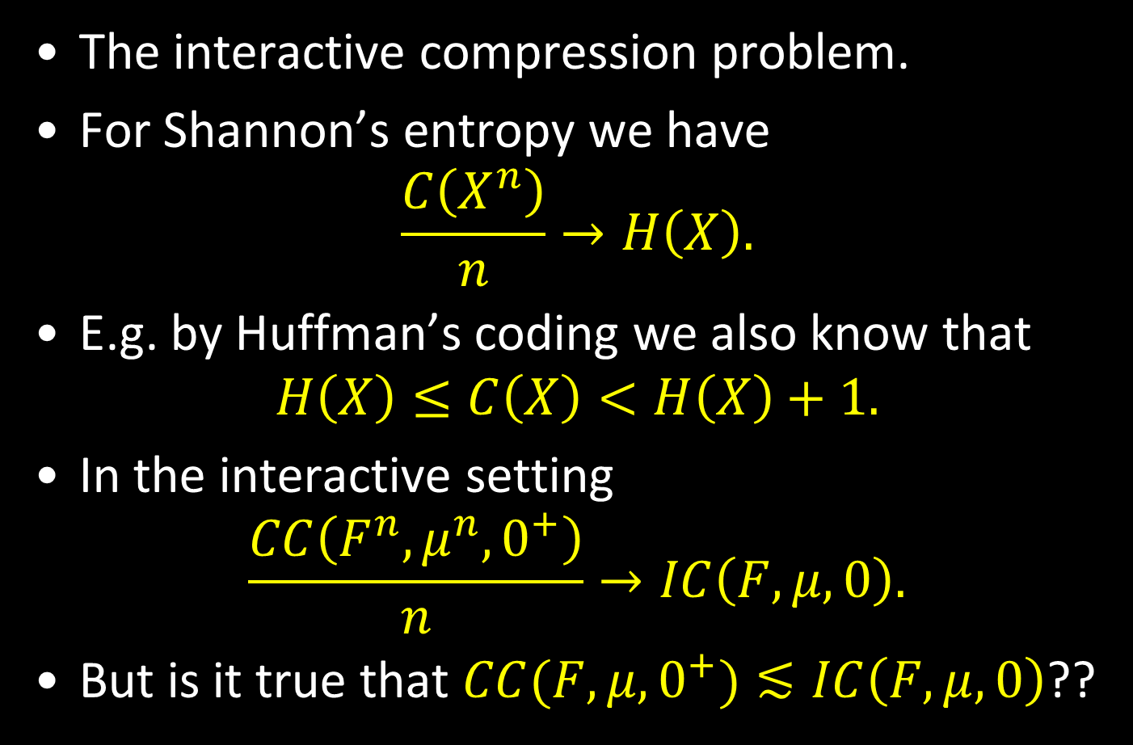
Selected open problems 1
The interactive compression problem.
For Shannon’s entropy we have
$$\frac{C\left(X^{n}\right)}{n}→H\left(X\right).$$
E.g. by Huffman’s coding we also know that
$$H\left(X\right)≤C\left(X\right)<H\left(X\right)+1.$$
In the interactive setting
$$\frac{CC\left(F^{n},μ^{n},0^{+}\right)}{n}→IC\left(F,μ,0\right).$$
But is it true that $CC(F,μ,0^{+})≲IC\left(F,μ,0\right)$??

Slide 43

Interactive compression?
$CC(F,μ,0^{+})≲IC\left(F,μ,0\right)$ is equivalent to
$CC(F,μ,0^{+})≲$ $\frac{CC\left(F^{n},μ^{n},0^{+}\right)}{n}$, the “direct sum” problem for communication complexity.
Currently best general compression scheme [BBCR’10]: protocol of information cost $I$ and communication cost $C$compressed to $\tilde{O}(\sqrt{I⋅C})$ bits of communication.

Slide 44

Interactive compression?
$CC(F,μ,0^{+})≲IC\left(F,μ,0\right)$ is equivalent to
$CC(F,μ,0^{+})≲$ $\frac{CC\left(F^{n},μ^{n},0^{+}\right)}{n}$, the “direct sum” problem for communication complexity.
A counterexample would need to separate IC from CC, which would require new lower bound techniques [Kerenidis, Laplante, Lerays, Roland, Xiao’12].

Slide 45

Selected open problems 2
Given a truth table for $F$, a prior $μ$, and an $ε≥0$, can we compute $IC(F,μ,ε)$?
An uncountable number of constraints, need to understand structure better.
Specific $F$’s with inputs in $\left\{1,2,3\right\}×\{1,2,3\}$.
Going beyond two players.

Slide 46

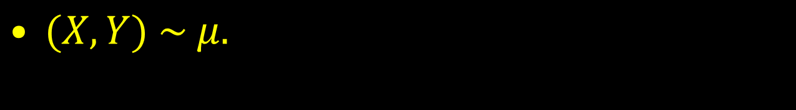
External information cost
$(X,Y) \sim μ.$
X
C
Y
Protocol transcript $Π$
Protocol π
A
B
$$ICext\left(π, μ\right)= I\left(Π;XY\right)≥I\left(Π;Y | X\right)+I(Π;X|Y)$$
what Charlie learns about $(X,Y)$

Slide 47
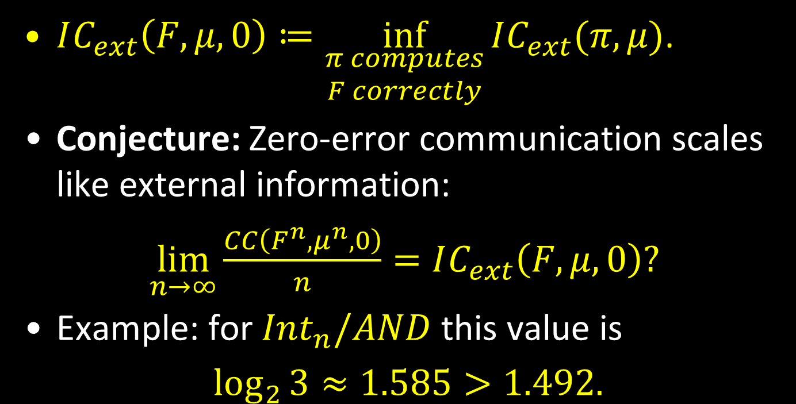
External information complexity
$IC_{ext}\left(F,μ,0\right)≔\inf_{\begin{aligned}π computes \\ F correctly\end{aligned}}{IC_{ext}(π,μ)}$.
Conjecture: Zero-error communication scales like external information:
$\lim_{n→∞}{\frac{CC\left(F^{n},μ^{n},0\right)}{n}}=IC_{ext}\left(F,μ,0\right)?$
Example: for $Int_{n}/AND$ this value is
$\log_{2}{3}≈1.585>1.492.$

Slide 48
Thank You!

